Slide 1
DWIHN HEDIS Measures Vital Data Quality Scorecard

Slide 2
What is HEDIS?
The Healthcare Effectiveness Data and Information Set (HEDIS®) is a set of performance data developed and maintained by the National Committee for Quality Assurance (NCQA), and is the most widely used standardized performance measure in the managed care industry. HEDIS is part of an integrated system to establish accountability in managed care.
Behavioral health has multiple measures that include ensuring continuity of care, for example; appropriate psychotropic medication management/adherence, follow up after hospitalization, and diabetes monitoring. Detroit-Wayne Integrated Health Network collects HEDIS data to measure and improve the quality of care that the members receive.

Slide 3
HEDIS Quality Scorecard
Anyone who has access to MHWIN can access their CRSP HEDIS Quality Scorecard. If you do not have access to MHWIN please contact the MHWIN help desk at mhwin@dwmha.com.
The HEDIS Quality Scorecard includes 15 HEDIS measures and 1 custom measure (UAM45).
DWIHN expects CRSP’s to have a process of how and who will monitor the scorecard and steps to meet the HEDIS Measures.
All employee roles within the CRSP have access to the HEDIS Quality Scorecard.
Scores for individual CRSP will be monitored by DWIHN.
HEDIS Quality Scorecard includes CRSP total score, member included in score and if they met the measure. All data can be exported to an excel or PDF document.

Slide 4
To Access Click on Provider Link

Slide 5
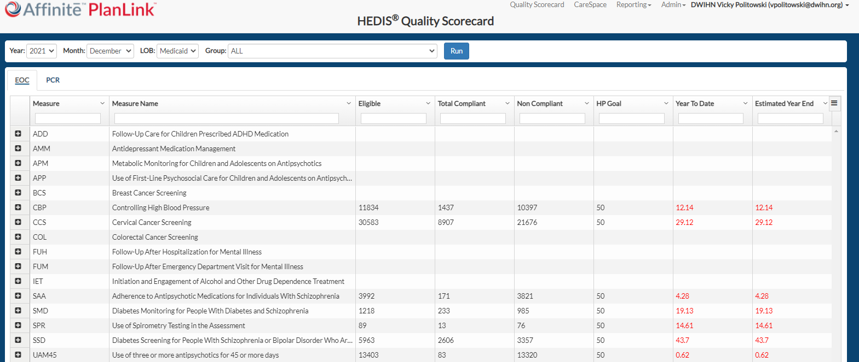

Slide 6
Year: Data from 2019-2022 can be filtered.
Month: Can look at data until a certain month.
LOB: Medicaid Members.
Group: CRSP that is assigned to user.
RUN: Press RUN after Year and Month are selected.

Slide 7
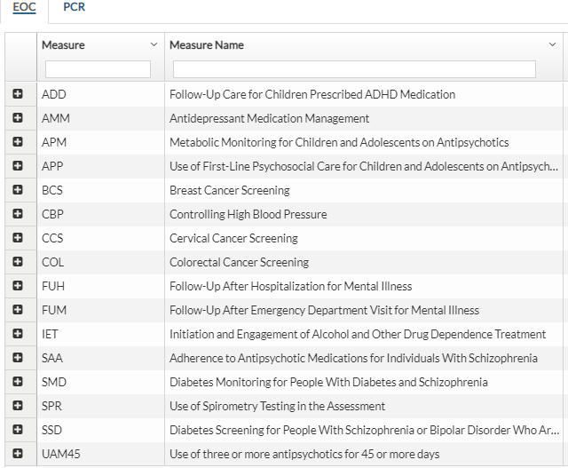
EOC: HEDIS Measure
PCR: Plan All-Cause Readmission Rate
Measure: Acronym of HEDIS Measure
Measure Name: Name of HEDIS MEASURE
+ Allows measure to be expanded down to member detail.

Slide 8
Eligible: Number of members eligible for measure
Total Compliant: Number of members that meet the measure
NON-Compliant: Number of members not meeting measure
HP Goal: Goal percent set by HEDIS measure as of today
Year to Date: CRSP percentage on goal
Estimated Year End: The current trend based on how many are meeting the goal as of that date

Slide 9
Click this button to export data to an excel or PDF document.
Use this bar to move the screen up or down.

Slide 10
All lines separating columns can be moved to further see text.

Slide 11
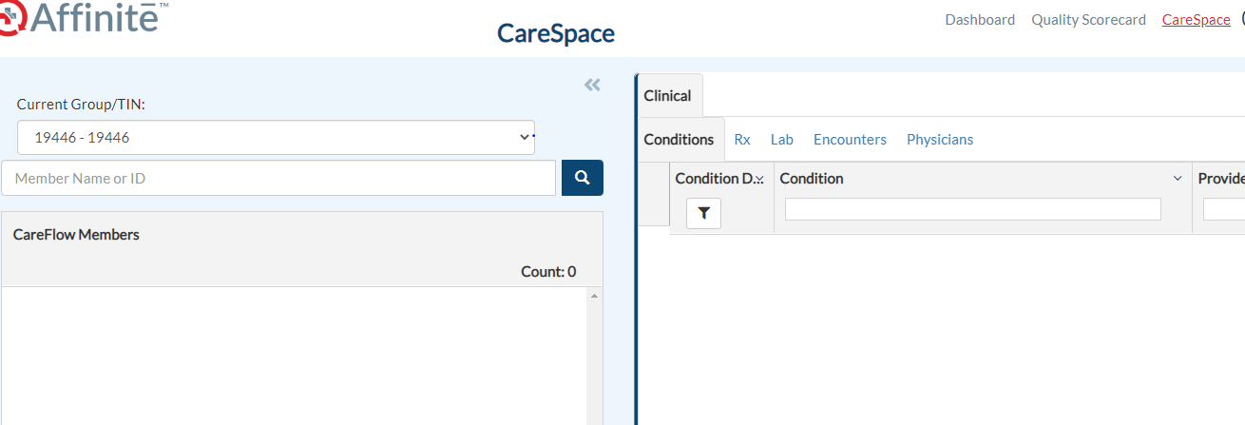
CareSpace Data

Slide 12
Click on CareSpace

Slide 13
CRSP assigned will appear
Can Search by individual member
There will be a number following “Count”
All members assigned to CRSP will appear here.

Slide 14
Sort Button
Can sort members by:
Member Name
Member ID (Medicaid number)
Provider
Disease Type/HEDIS Due
With Birthdate
Flow Reason
Tier 0-1 No medical diagnosis
Tier 2 Hospitalized for Medical in past year
Tier 3 Hospitalized for Psychiatric in past year

Slide 15
Example of the Member Detail
Can see Tiers
Can see HEDIS Measures not met
Click on Members name to see more detail on opposite side of screen.

Slide 16
Click on arrows to see member demographics
Click on “Conditions” to see diagnosis that a member has been identified with (medical and behavioral health).
Click on “Encounters” to see encounters from claims
Click on “Physician” to see a list of doctors that have treated member.

Slide 17
Tips
All Data is pulled from the states data warehouse, there is a lag time depending on when the data is received after it is billed to Medicaid.
If your data is not loading when you log in and go to the scorecard, try to do a ctrl+F5 before changing your dates/LOB. Your browsing history also may be holding on to old code, you can try clicking the three dots (...) to the right of your browsers address bar, click history from the drop down and then history at the top of that page. You should see a trash can with clear browsing data. TIP: uncheck the cookies box so that it doesn't wipe you all of you logins (requiring you to log into everything again).
Need to be in google chrome
If a mistake is made while navigating system, log out and log back in and it will be reset.

Slide 18
For further questions or trainings please contact:
Vicky Politowksi
Director of Integrated Care
Email: vpolitowski@dwihn.org
Cell: 313-670-7144

